Slide 1


Practical Statistics
Turning statistics into a toolkit for ecologists

Slide 2




Intro
Henry Häkkinen
Post-Doc studying the effects of climate change on seabirds and how to plan effective conservation. Latterly branched out into impacts of renewable energy on biodiversity.

Slide 3
Content for today
Overview of session:
What is “Bayesian” statistics?
Bayes’ theorem
Model design
Priors
Running a model
Model checks
Interpreting output
Bayesian versus Frequentist statistics
Practical: running example models in R!

Slide 4
Cut?: What are statistics?
The collection, organization, analysis, interpretation, and presentation of data
In science, we often use “statistics” as short-hand for “inferential statistics” which examines properties of data in relation to underlying probability distributions
This includes hypothesis testing! And most forms of classical models!
Alternatives include “descriptive statistics” which we use all the time (mean, median, standard deviation etc.)
In inferential statistics we attempt to quantify any patterns in our data, and just as importantly, the uncertainty around those conclusions.

Slide 5
What is a “Bayesian” approach?
An alternative type of statistical inference than that of frequentist statistics.
We use data and our prior knowledge of a system to build a statistical model, the output is known as a “posterior” distribution
Data
Model checks
Model design
Run the model!
Output (posterior)
Priors

Slide 6
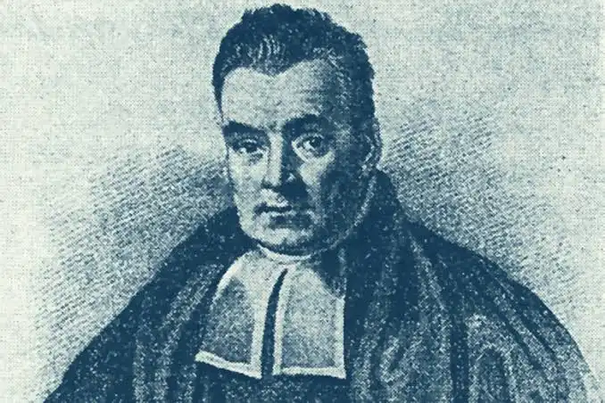
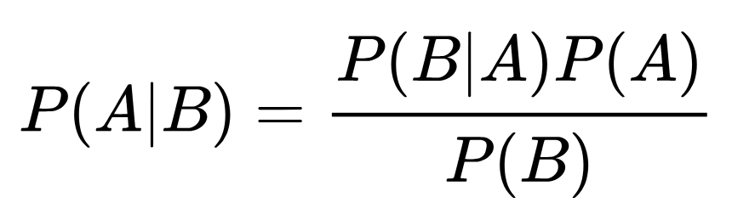
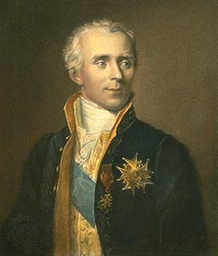
Bayes’ Theorem
The Bayes theorem describes the probability of event A conditional on event B (the probability of A after B has already occurred).
This is calculated using the probability of B conditional on A (what are the conditions of B that A occurs under) and the two separate probabilities of the events A and B.

Slide 7
Bayes’ Theorem
A simple example: What is the probability that a patient has a disease (A) given that they tested positive for that disease (B)?
P(A|B) is the probability that they have the disease, given that they tested positive. The posterior
P(B) is the probability that someone tests positive, whether or not they have the disease. The marginal probability
P(A) is the probability they actually have the disease (the overall incidence rate of a disease in the population). The prior.

Slide 8
Bayes’ Theorem
The Bayes’ theorem in practice:
“The serum test screens pregnant women for babies with Down’s syndrome. The test is a very good one, but not perfect. Roughly 1% of babies have Down’s syndrome. If the baby has Down’s syndrome, there is a 90% chance that the result will be positive. If the baby is unaffected, there is still a 1% chance that the result will be positive. A pregnant woman has been tested and the result is positive.”
What is the chance that her baby actually has Down’s syndrome?
48%! This is non-intuitive, but the knowledge of the general probability of prevalence has revealed some interesting information!

Slide 9
What is a “Bayesian” approach?
An alternative type of statistical inference than that of frequentist statistics.
https://esajournals.onlinelibrary.wiley.com/doi/10.1890/14-0661.1
https://tobiasroth.github.io/BDAEcology/basics.html
https://besjournals.onlinelibrary.wiley.com/doi/10.1111/2041-210X.13407

Slide 10

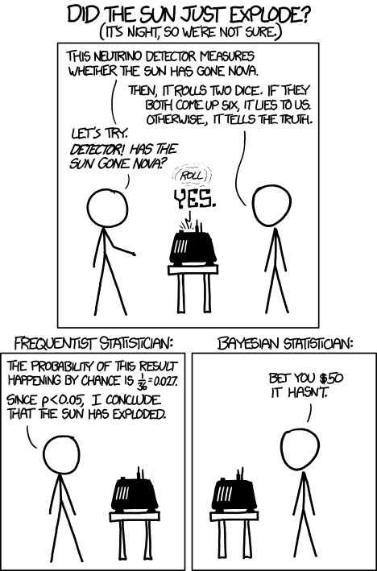
Part 1: Data and model design
The basic process for making a Bayesian model works like this:
define the model
define the priors
https://xkcd.com/1132/

Slide 11
What is a “Bayesian” approach?
We are going to run a simple example to illustrate a simple Bayesian modelling process
Data
Model checks
Model design
Run the model!
Output (posterior)
Priors

Slide 12
Example Data: Mutated Centipedes
Noddy-over-sands had a mysterious chemical leak in the 1950s. The cleanup was long and difficult, but was declared safe by the government. However, local ecologists have noticed that centipedes in the area of the spill are much larger than expected. They want to analyse past data and see if centipedes nowadays are larger than those of the past.

Slide 13
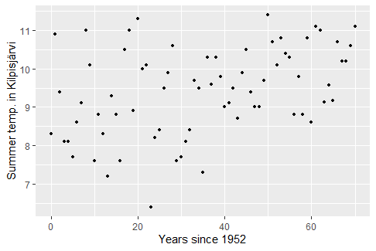
Example Model: Mutated Centipedes
A frequentist model requires a distribution to use as its basis. So do Bayesian models!
Common examples are: normal, binomial, Poisson, negative binomial, beta, gamma…
We use this to model a relationship between predictors and response variables.
What kind of distribution does this look like?

Slide 14
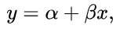
Example Model: Mutated Centipedes
This looks linear to me! I could use a normal linear regression with a frequentist approach, but I’ve decided to use a Bayesian approach.
What does a linear model look like?
y ~ a(x) + b ->
b is the intercept
a is the slope of the line

Slide 15
Build and run the model
There are a lot of ways to build models in R!
They all use the same mathematical approach, but notation and technical details differ:
Rjags
Rstan
rstanarm
brms
R2OpenBUGS
LaplacesDemon
And probably more….
Some are very technical and require a lot of work to run. Some hide a lot of the Bayesian aspects to make it look more like a standard frequentist model. Which you use is up to you, but I really dislike packages that “pretend” they’re frequentist so they look more friendly, I would advise to avoid them

Slide 16
Build and run the model
For example:
Stan model:
Brms model:

Slide 17
Build and run the model
We are going to use a hard-core approach, where we define everything ourselves
Why? Because one of the major advantages of Bayesian models are their flexibility. You can use them for nearly anything! If you use pre-defined models, you are constrained to what the package can do. If you define the model yourself you can do anything!
If you can code a model yourself, you understand everything it’s doing.
Nearly all major packages are based on stan, which is what we’re going to use.

Slide 18
Example Model: Mutated Centipedes
y ~ a(x) + b ->
b is the intercept
a is the slope of the line
[show model design with arrows]

Slide 19
Writing Bayesian models
On a practical level, how do you actually write a Bayesian model?
After you have decided on a distribution, you have several options
1) Use a package that pre-defines it. Many R packages will have pre-built models which you can use as a “plug-in” piece
2) Look up examples online. Many models will have examples and tutorials. Work through examples and go from there.
Start simple! Build a model with one or two parameters, then build complexity (e.g. more variables, more parameters)

Slide 20
Part 2: Priors
Data
Model checks
Model design
Run the model!
Output (posterior)
Priors
https://xkcd.com/1132/

Slide 21
Define the priors
Is there any relevant information we should incorporate about this system? If this is not a new study system, there may be information about what you expect to see (e.g. mortality rate in a wildlife population can be estimated from previous work)
Priors provide the model information to use, and inform it what are the expected results and estimates for our parameter.

Slide 22
Define the priors
Priors can seem odd at first because they are not objective observations, but subjective decisions.
You can make priors flexible so if they are wrong, then your model can adjust and update the priors. Think of priors as a good starting point for your model, not as prescriptive.
Priors make modelling faster as models only trial the parameter estimates we tell it to. They also rule out physically impossible, but mathematically valid, answers. They also can account for uncertainty in observations

Slide 23
Example Priors: Mutated Centipedes
What kind of priors can we discern about our system?
We have two parameters, so we need two priors.
What would make a suitable “null” prior?
?

Slide 24
Define the priors
We have two parameters, so we need two priors.
What is a reasonable expectation for our intercept (alpha)?
It cannot be below 0 otherwise hard to tell. So we should set a positive prior.
Otherwise it could be anywhere between 6-12 (and probably in the middle)
?

Slide 25
Define the priors
We have two parameters, so we need two priors.
What is a reasonable expectation for our slope (beta)?
We have no expectation on positive or negative slope (null hypothesis is slope is 0), but it could be either
So we set a prior with a centre point of 0, but with the flexibility to move to positive or negative.
But how much flexibility?
?

Slide 26
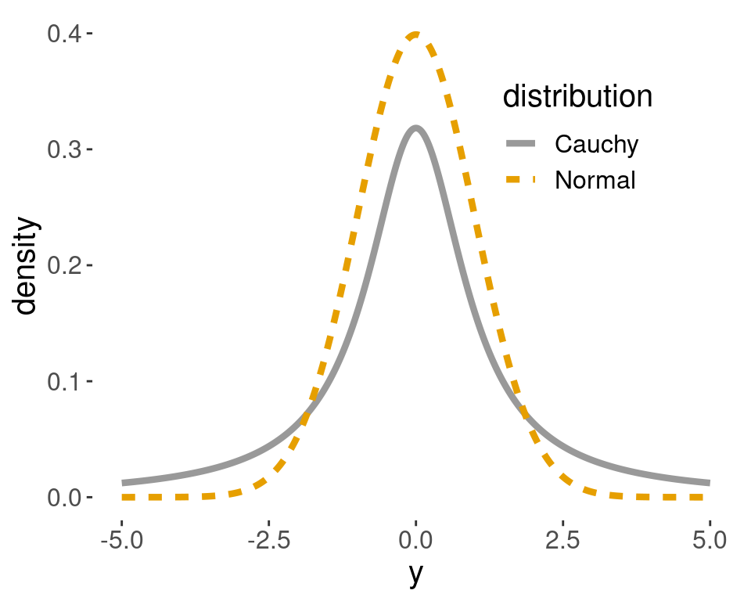
For linear regressions we often have a null hypothesis that there is no relationship between a predictor and the response variable (i.e. slope is 0).
In which case we might assume our β prior is around 0, but might be positive and negative
We can restrict this by setting a limit on how positive or negative it can be.
A strict limit is referred to as “strongly informative” or “enthusiastic” prior
A loose limit with a lot of flexibility is referred to as a “weakly informative” or “skeptical” prior

Slide 28
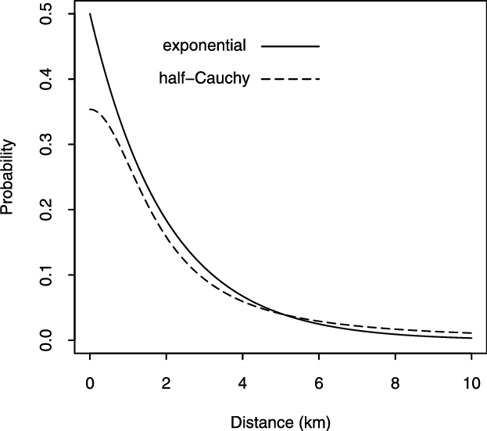
In other cases we may expect a parameter to always be positive, but likely to be close to 0 if the null hypothesis is true.
And so on! There are many types of different distributions for different applications.

Slide 29
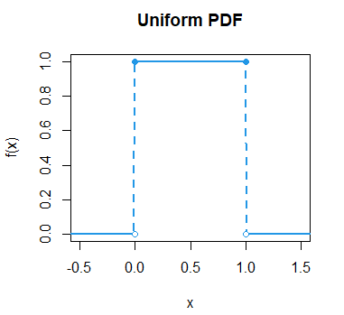
If we have no prior information about the system we can set an “uninformative” prior
Many people favour this as it appears to be “neutral”, but beware! It can bias results more than an informative prior!
It can also cause models to be a lot slower as it has more parameter space to check
Common sense will often tell us some results are impossible
E.g. cannot have a negative mortality or growth rate!

Slide 30
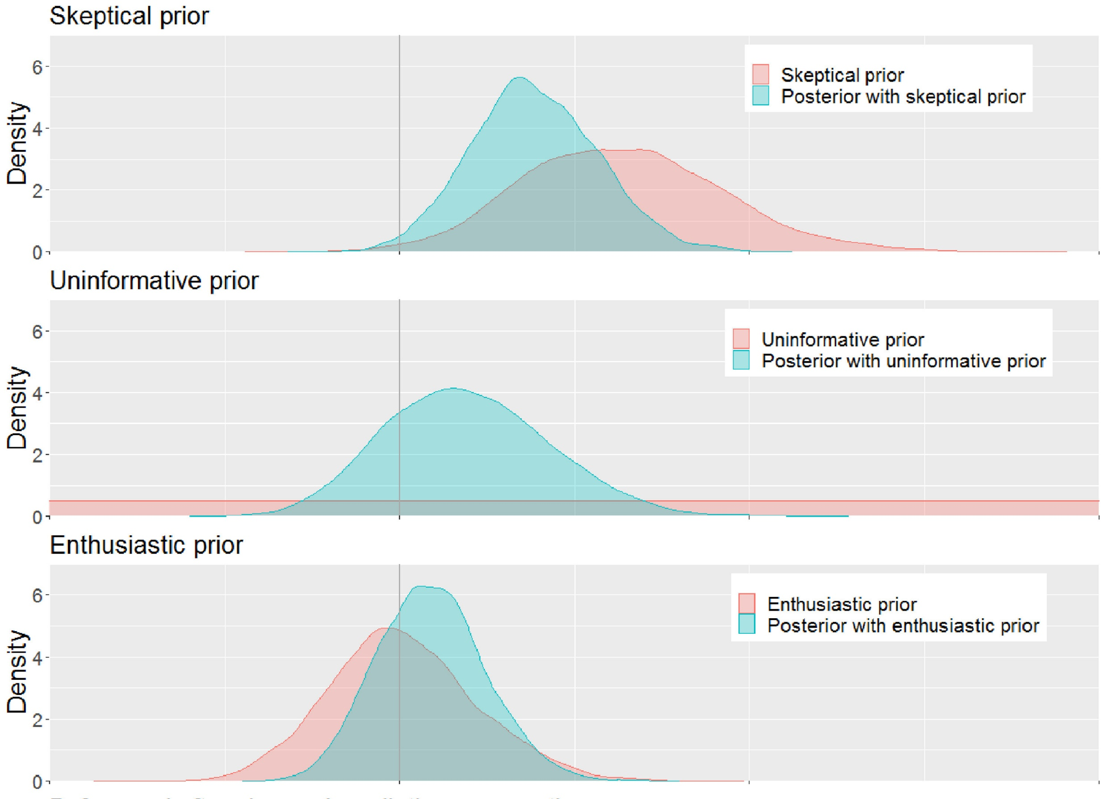
Your choice of priors can affect your results. Always make sure you can defend your priors.

Slide 31
The Bayesian Approach: Example
It is up to us on how restrictive or flexible the priors are
Some packages choose priors for you, or hide them altogether. Be VERY careful when using these.
https://www.redjournal.org/article/S0360-3016%2821%2903256-9/fulltext

Slide 32
Part 3: running the model
Data
Model checks
Model design
Run the model!
Output (posterior)
Priors
https://xkcd.com/1132/

Slide 33
Build and run the model
We are going to use rstan!
It runs C++ in the background, rstan is just the R wrapper on the top
It is extremely fast, powerful and flexible, BUT requires asome knowledge and work to get it to work
Many (if not most) Bayesian packages are based on stan, but are simplified
I will teach using stan, because
All the major principles are the same across packages
It forces you to be specific and to understand all the major components of a Bayesina model
If you understand rstan, then many other packages are very similar, but easier!

Slide 34
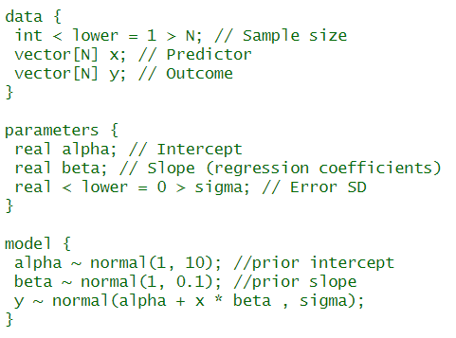
Build and run the model
Stan has three parts to a model
Data: we have to state all the relevant parameters, including sample size! We have to declare what type of data it is.
Parameters: we have to declare all the parameters in the model, and an error term
Model: we have to declare the formula for our model, and our model priors.
For most common models, you can find many examples on line.

Slide 35
How does a Bayesian model actually work?
Bayesian models will take the input data and model and try to estimate the best possible answers and present its results for parameter estimates
How? Through iteration. It will try lots of different combinations of parameters, measure how well these fit the data (through log-likelihood fitting), and report back what it finds. It will use previous results to improve its guesswork going forward. This approach is collectively known as Monte Carlo sampling, of which there are various sub-types.
In total, a Bayesian model will often run tens of thousands of iterations, and will “converge” towards a consensus answer. The answer will never be perfect, but will be very close to the correct answer.

Slide 36
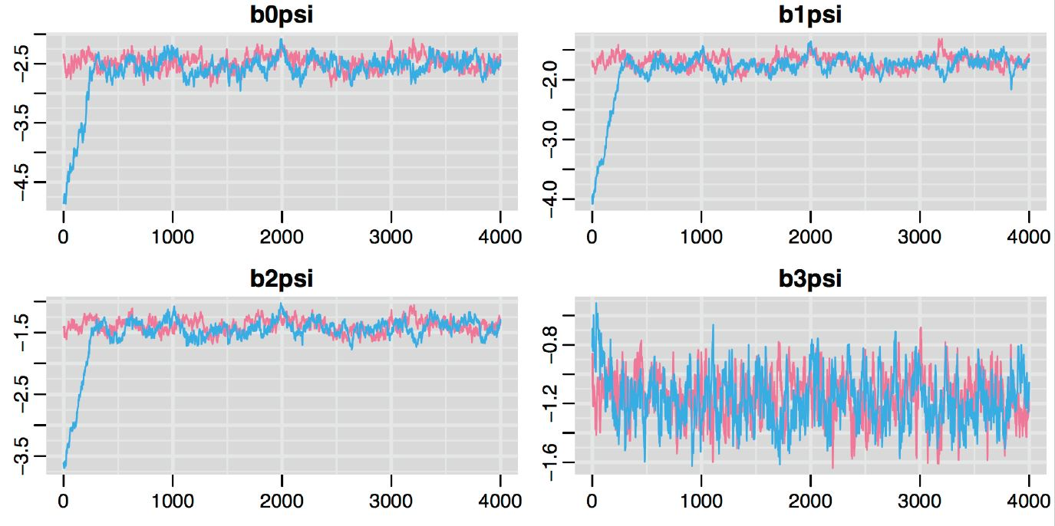
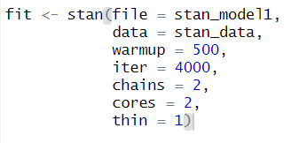

Slide 37
Key model options:
Iterations
Burn-in/warm-up
Chains
Thin
Cores:

Slide 38
Part 3: running the model
Data
Model checks
Model design
Run the model!
Output (posterior)
Priors
https://xkcd.com/1132/

Slide 39
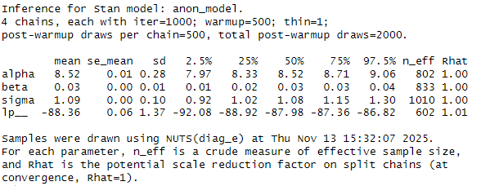

Slide 40
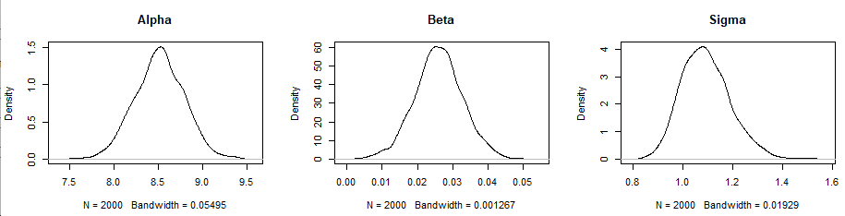
Parameters will normally look normally distributed.
Multiple peaks means model cannot find a single, valid solution
Strong skew sometimes mean your priors are constraining the model

Slide 41
Key checks:
Model converges to stable space, all chains show similar behaviour
“fuzzy caterpillar”
Rhat should be close to 1.0
Do posterior distributions look sensible?

Slide 42
Part 5: understanding output
Data
Model checks
Model design
Run the model!
Output (posterior)
Priors
https://xkcd.com/1132/

Slide 43
Bayesian models do not give point estimates, standard errors, or p-values!
Instead, they have an estimate per parameter per iteration, these are then formed into a posterior distribution
We can use this to make a mean estimate, and a 95% confidence interval

Slide 44
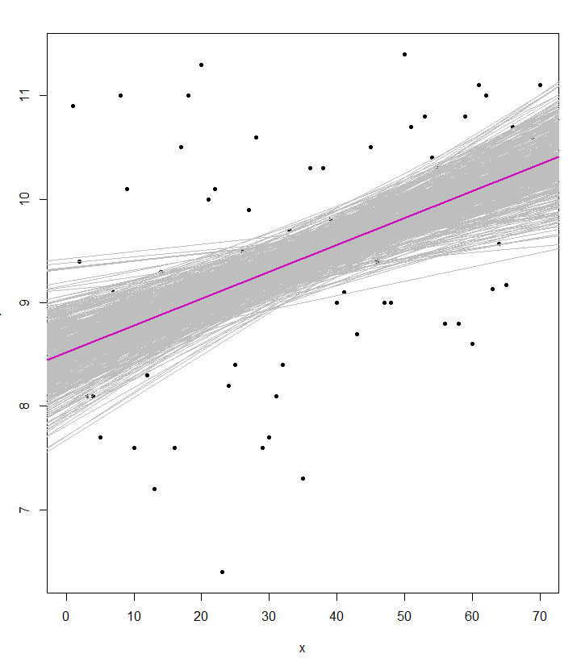
Bayesian models do not give point estimates, standard errors, or p-values!
Instead, they have an estimate per parameter per iteration, these are then formed into a posterior distribution
We can use this to make a mean estimate, and a 95% confidence interval

Slide 45
Bayesian models do not give point estimates, standard errors, or p-values!
Instead, they have an estimate per parameter per iteration, these are then formed into a posterior distribution
We can use this to make a mean estimate, and a 95% confidence interval
[to-do make 95th estimate plot)

Slide 46
When we report Bayesian statistics, we usually report our mean parameters estimate and a chosen confidence interval (often 95%)

Slide 47
Checking model fit
You cannot calculate classical residuals in a Bayesian approach
But that doesn’t mean we cannot check model performance!
Key ways to check are:
Posterior predictive checks = can our model predict our data well? Does it have any obvious flaws?
Validation = build the model with a part of the data-set, can it successfully predict the left-out part
Note: some packages provide residuals, but they are technically different to ones you’re used to. Read up on them if interested!

Slide 48
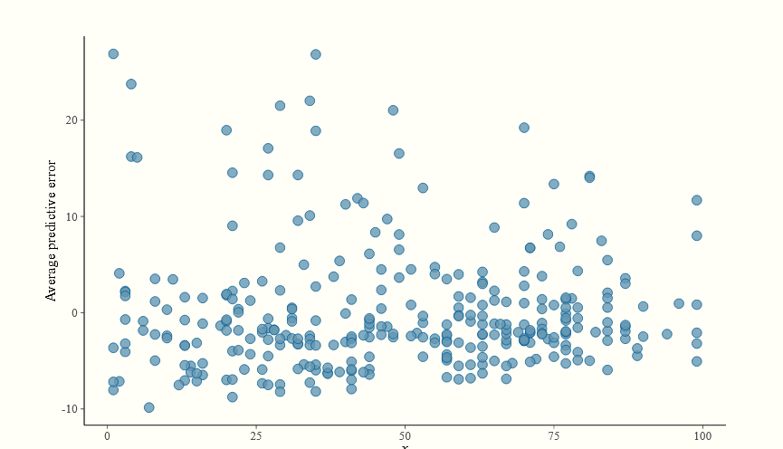
The Bayesian Approach: Example
Posterior predictive checks = can our model predict our data well? Does it have any obvious flaws?

Slide 49
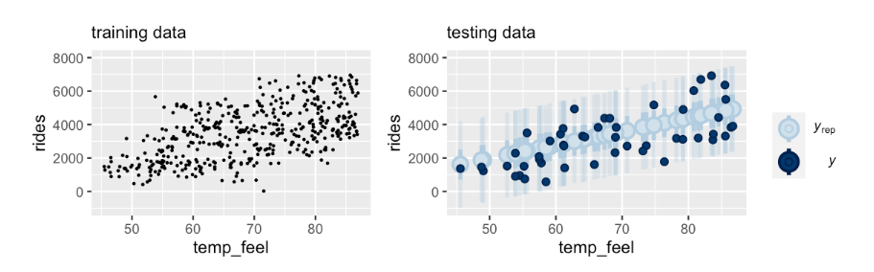
The Bayesian Approach: Example
Validation = build the model with a part of the data-set, can it successfully predict the left-out part
y
y
x
x

Slide 50
Part 6: Model Comparisons

Slide 51
Sometimes we might want to build different models with different priors, model structures and parameters. In which case we need to compare them and find which performs better
In a frequentist framework, we might use AIC, etc
Bayesian frameworks have equivalents, that essentially work the same way!
Common ones include: BIC, WAIC, etc

Slide 52
Part 7: Frequentist vs Bayesian

Slide 53
Key differences
Both are valid approaches for almost every statistical question, they just work differently
You are run a linear regression using a frequentist or Bayesian approach and they will likely give the same answer.
Advantages of Frequentist approach:
Generally faster, especially for simpler models
Still standard approach in ecology so better tutorials and support
Larger array of tools and packages to solve standard problems, little customisation needed
Results are (often) more interpretable, with single estimates
Advantages of Bayesian approach:
Generally better at modelling complex systems, especially with small sample sizes
Much more powerful and flexible, can solve statistical problems that frequentist approaches cannot
Credible intervals are usually more robust, generally give a more intuitive sense of uncertainty

Slide 54
Key differences
Both are valid approaches for almost every statistical question, they just work differently
You are run a linear regression using a frequentist or Bayesian approach and they will likely give the same answer.
Advantages of Frequentist approach:
Generally faster, especially for simpler models
Still standard approach in ecology so better tutorials and support
Larger array of tools and packages to solve standard problems, little customisation needed
Results are (often) more interpretable, with single estimates
Advantages of Bayesian approach:
Generally better at modelling complex systems, especially with small sample sizes
Much more powerful and flexible, can solve statistical problems that frequentist approaches cannot
Credible intervals are usually more robust, generally give a more intuitive sense of uncertainty

Slide 55
The Bayesian Approach: When do I use it?
If it makes sense for your data (heavy conditional probabilities)
If standard frequentist methods don’t work
Lots of random effects?
Highly hierarchical data?
No standard distributions work?
Other problems that can’t be modelled easily in a frequentist approach (e.g. heteroskedasticity)?
If the model you wish to build has too much complexity for the sample size. Bayesian approaches can compensate for small sample sizes to some extent, especially for categories, interactions and other terms that require a large number of degrees of freedom in a frequentist approach
If you like the Bayesian approach and have a lot of time on your hands!
Makes you specify your model and really understand your data
Also takes time and experience to run them!

Slide 56
Differences between Frequentist and Bayesian: part 2

Slide 57
Bayesian Statistics
Bayesian statistics use a different approach. There is no null model, there are no p-values, and no residuals (sort of). There is no theoretical “ideal” distribution. Instead, the data is considered to be “reality” and we just see how well we can describe it mathematically.
Bayesian statistics rely heavily on priors. This is information we provide to the model about what we think reality is like
This reliance on “Bayes theorem” is critical. We tell the model what we think reality is like, and then the model find parameters to describe it.
This may seem odd, and subjective, but it is more important and appropriate than you think

Slide 59
Wait, what are frequentist statistics?
Probably most, if not all, statistical tests you have done up until this point:
T-tests, linear models, GLMs, GLMMs etc.
Quick test: if it has a p-value it’s probably frequentist
In a frequentist approach we assume there is an overall global distribution, from which our data are just samples
E.g. normal, binomial, Poisson etc.
Frequentist statistics assess:
Whether the data fits our assumed distribution
Whether our data differs from a “null” distribution for hypothesis testing

Slide 60
Side note:
Broadly speaking there are four branches of statistical inference you are likely to come across
Inferential Statistics
Frequentist Statistics
Bayesian Statistics
Likelihood
Information Criteria
Common uses:
Maximum Likelihood Estimation
Likelihood-ratio tests (model comparison)
Common uses:
Aikake Information Criterion (AIC)
Relative model quality and model selection
Some approaches combine these!

Slide 61
Part 4: Exercises

